Slide 1



Metagame Analysis
Herbert Yuan

Slide 2

Project Description
Splatoon 2 is Nintendo’s multiplayer third-person shooter that pits teams of four ink-shooting squid-kids against each other in objective based matches. This project seeks to better understand the early metagame of Splatoon 2 in by analyzing the weapon usage of top North American League Battle players.
Primarily motivated by personal interests, I have always wondered what the “best” weapons were and whether certain weapons were truly overused. The early metagame is also the most interesting as players discover new strategies and tactics while developers enact patches to balance overpowered items.

Slide 3

Data Acquisition
Splatnet 2
API
Timeseries
Dataframe
Outer join on Weapon Name
Weapon usage gathered and compiled by timtlm
Extract Weapon Name and Usage
Week n
Dataframe
Week 1
Dataframe
Weekly Summary CSVs

Slide 4
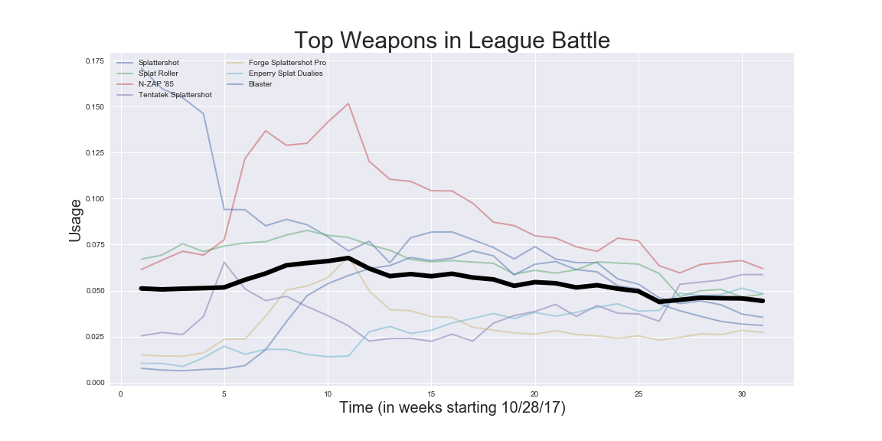
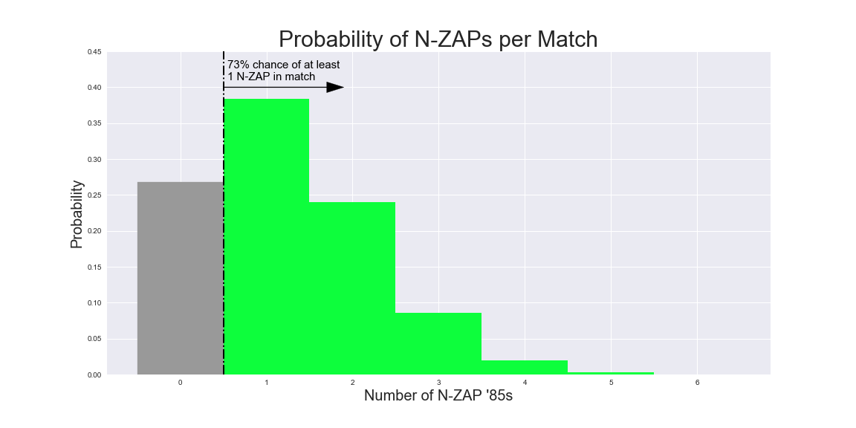
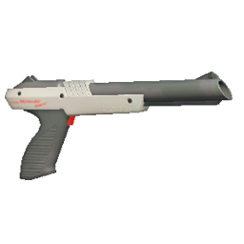
The Overused
N-ZAP ‘85

Slide 5

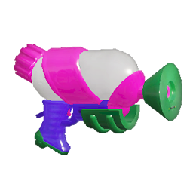
Hypothesis Testing
Scientific Question:
Was the N-ZAP '85 used more on average than the Splattershot?
Null Hypothesis:
The N-ZAP '85 was used, at most, equally as the Splattershot.
Alternate Hypothesis:
The N-ZAP '85 was used more than the Splattershot.
Rejection Threshold:
Use the standard α = 0.05
Splattershot
N - ZAP ‘85
Calculate p-value using Mann Whitney U test:
p = 0.064
Compare p-value to Rejection Threshold:
Fail to reject null hypothesis, meaning the data does not show that the N-ZAP ‘85 is used more than the Splattershot.

Slide 6
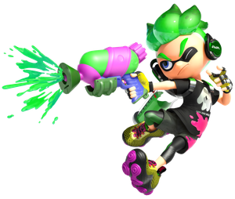
Conclusion
While analysis of the N-ZAP was insightful and sometimes surprising, I would have liked to look into a wider range of weapons. I have barely scratched the surface of my data since I ended up focusing too much on the N-ZAP and not getting as much as I wanted out of it. I hope to continue with this topic as I am deeply interested in it and feel that there is still a lot more investigation to do.
Next steps:
Integrate with database to better manage more data.
Scrape patch notes from the Splatoon Wiki for more insight on meta changes.
Get data for Rank X (solo queue) players to compare the differences to premade teams.

